Slide 1
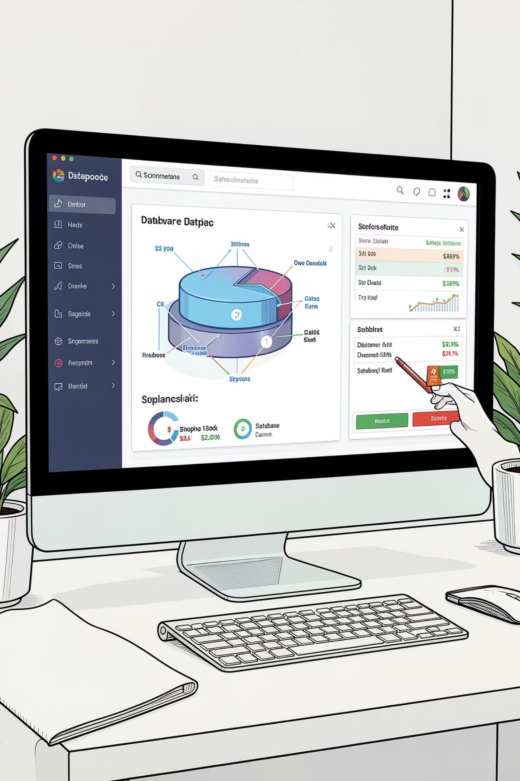
E-Commerce Management System
Using Java Swing and MongoDB
ADVANCED DATABASE MANAGEMENT SYSTEMS (ADBMS)
Submitted By: Shifa Batool · Alia Kalwar
Department of Computer Science · Sukkur IBA University

Slide 2
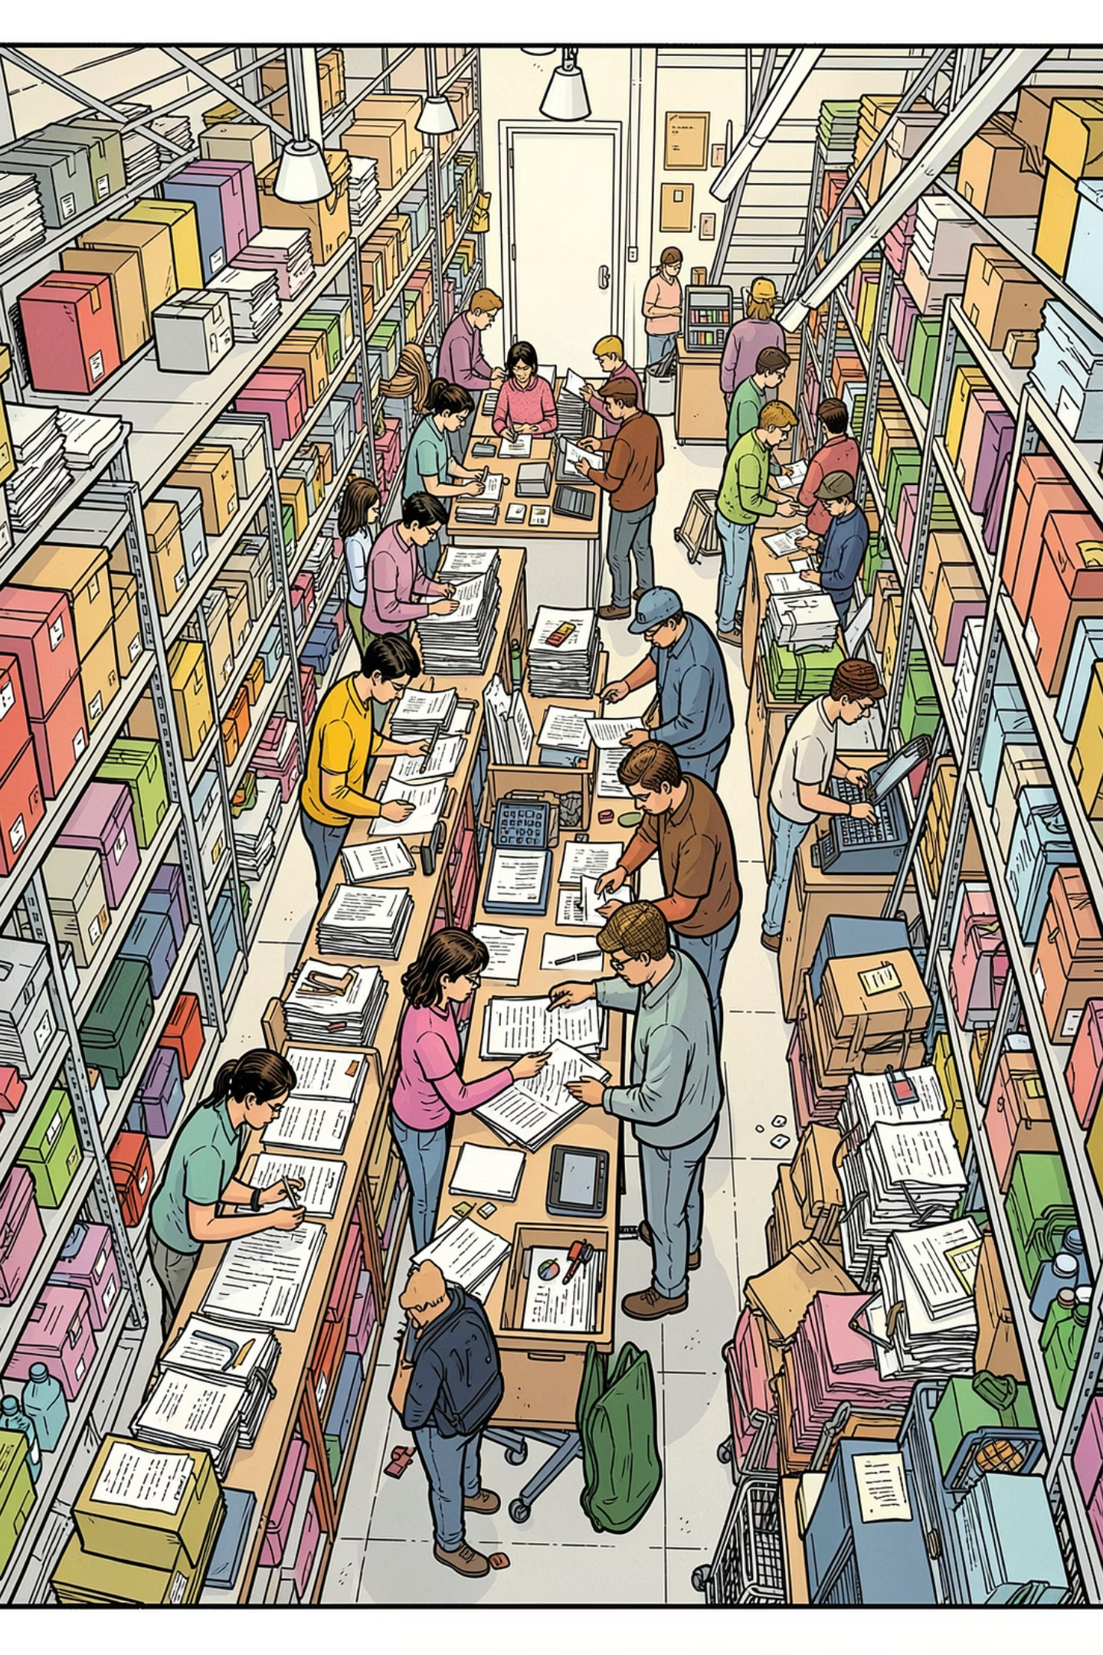
Introduction & Problem Statement
E-commerce platforms manage products, customers, carts, and orders — but manual systems are inefficient and error-prone.
The Challenge
Manual record-keeping causes data redundancy
Inventory and order tracking become unreliable at scale
Businesses need efficient, automated transaction handling
Our Solution
A desktop-based E-Commerce Management System built with Java Swing and MongoDB — automating product, customer, cart, and order management.

Slide 3
Project Objectives
1
2
Desktop Application
MongoDB Integration
Develop a Java Swing GUI for intuitive product, customer, and order management.
Connect Java to MongoDB via the official driver for flexible NoSQL data storage.
3
4
CRUD Operations
NoSQL Demonstration
Implement Create, Read, Update, and Delete across all four collections.
Showcase document-based data modeling using real-world e-commerce scenarios.

Slide 4
Technology Stack
Java
Java Swing
MongoDB
Core programming language for application logic and backend processing.
GUI framework for building the desktop interface — forms, tables, and menus.
Document-oriented NoSQL database storing data in flexible JSON-like collections.
MongoDB Driver
Maven
Official Java driver enabling seamless connectivity between the app and database.
Dependency management and project build automation for a clean, reproducible setup.

Slide 5
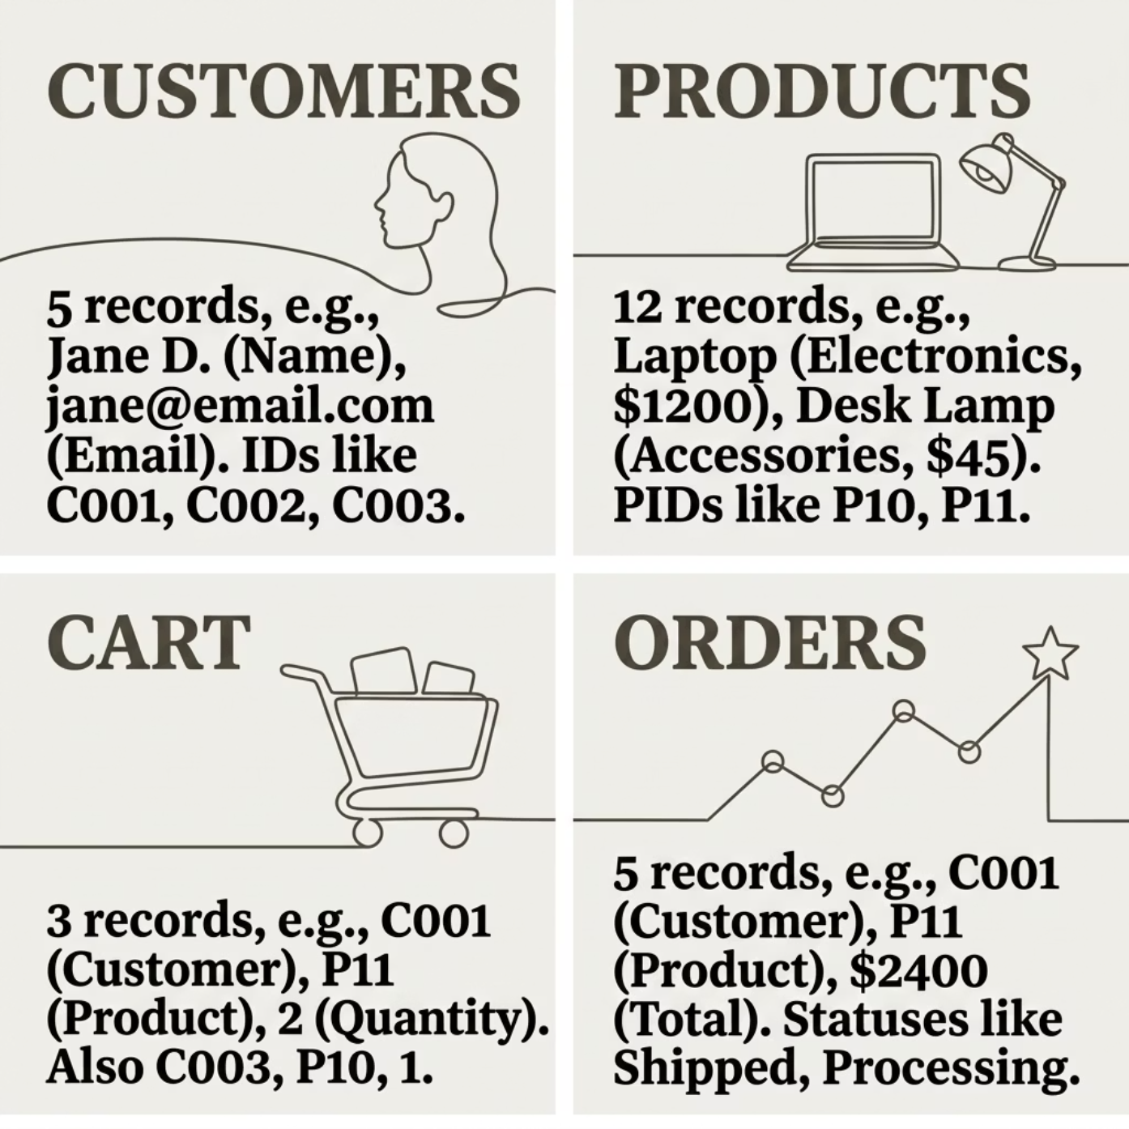
Database Design: EcommerceDB
The EcommerceDB database uses four document-based collections, eliminating rigid schemas and enabling scalable data modeling.
👤 Customers
📦 Products
🛒 Cart
📋 Orders
5 records
12 records
3 records
5 records

Slide 6
Collections: Customers & Products
Customers Collection
Products Collection
Stores registered user profiles with unique IDs for order linkage.
12 products across three categories with pricing and stock data.
Field
Type
Example
Electronics
Accessories
Customer ID
String
C001
Laptop, Smart Phone, Headphones
Power Bank, Cables, Cases
Name
String
Shifa
Email
String
shifa@example.com
Furniture
Gaming Chair, Desk, Lamp
Password
String
******

Slide 7

Collections: Orders & Cart
Orders Collection
Cart Collection
Captures completed transactions with status tracking.
Holds items selected before checkout.
Key Fields
Key Fields
Customer ID — links to buyer
Product ID — item purchased
Quantity & Total Amount
Status — Pending / Confirmed / Shipped
Customer ID — session owner
Product ID — selected item
Quantity — units added
Cart records persist across sessions, enabling a seamless checkout experience.

Slide 8
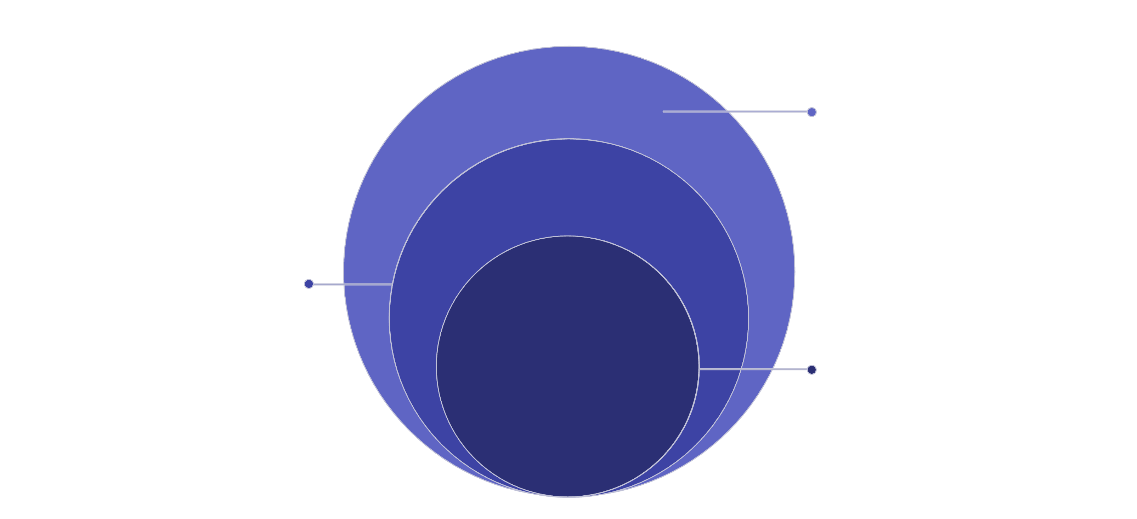
System Architecture
MongoDB Driver
Driver layer translating queries
Application Logic
Processes requests and enforces rules
Java Swing GUI
User-facing interface for interactions
The system follows a clean layered architecture. The Java Swing GUI handles all user interactions, passing requests to the Application Logic layer, which uses the MongoDB Driver to query and update the MongoDB Database — ensuring separation of concerns and maintainability.

Slide 9
CRUD Operations & System Features
CRUD Operations
System Modules
Create
Admin Module
Customer Module
Add products, register customers, place new orders
Add & search products
View all orders
Manage inventory
Browse products
Add to cart
Place & track orders
Read
View and search products, browse order history
Update
Modify product stock, update customer details
Delete
Remove obsolete records from any collection

Slide 10

Conclusion
✅ Delivered
🔗 Integrated
A fully functional E-Commerce Management System meeting all ADBMS project requirements.
Java Swing frontend seamlessly connected to MongoDB via the official Java driver.
📚 Demonstrated
Practical NoSQL concepts — document modeling, collections, and CRUD operations in a real-world context.
This project demonstrates that combining Java Swing with MongoDB provides a robust, scalable foundation for modern desktop-based e-commerce applications.
Thank You
Shifa Batool , Alia Kalwar
Department of Computer Science, Sukkur IBA University

